Slide 1
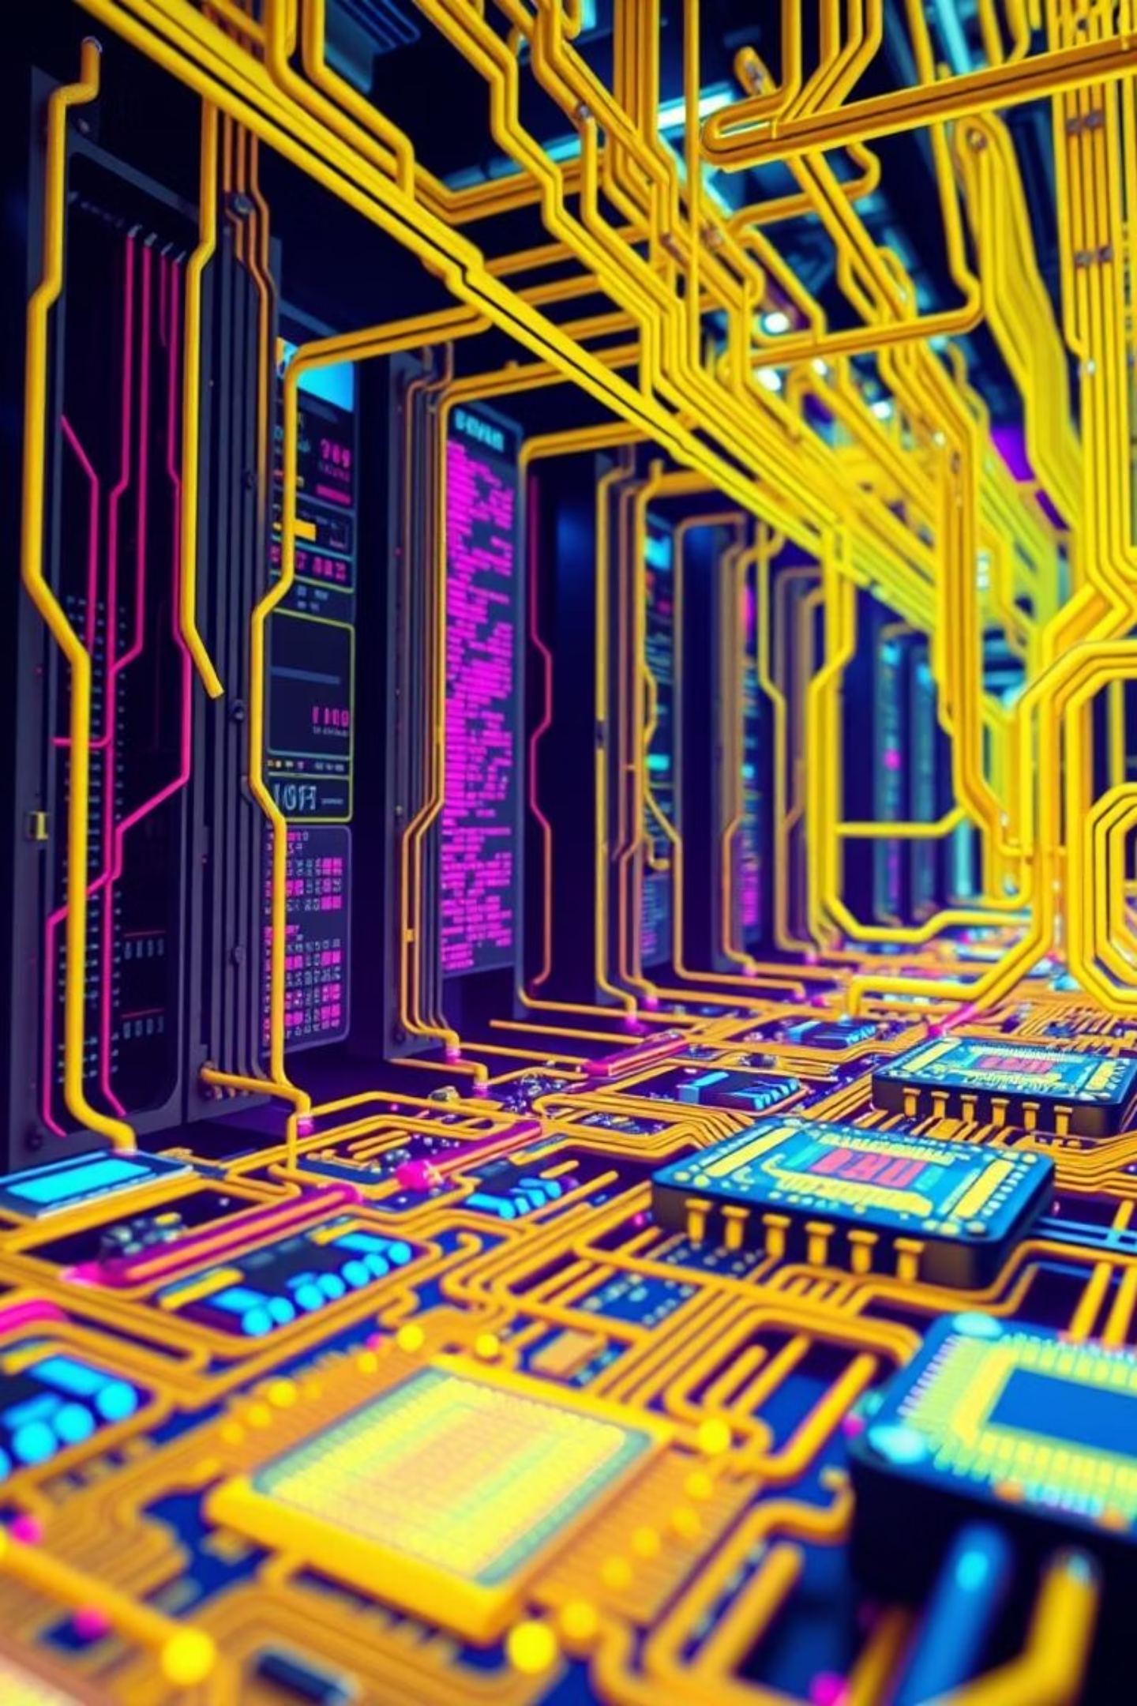
Multiprocessor & Multitasking: Unlocking Computing Power
Delve into the core concepts of modern computing that drive efficiency and performance. Understand how multiple processors and concurrent task execution revolutionise how we interact with technology.

Slide 2
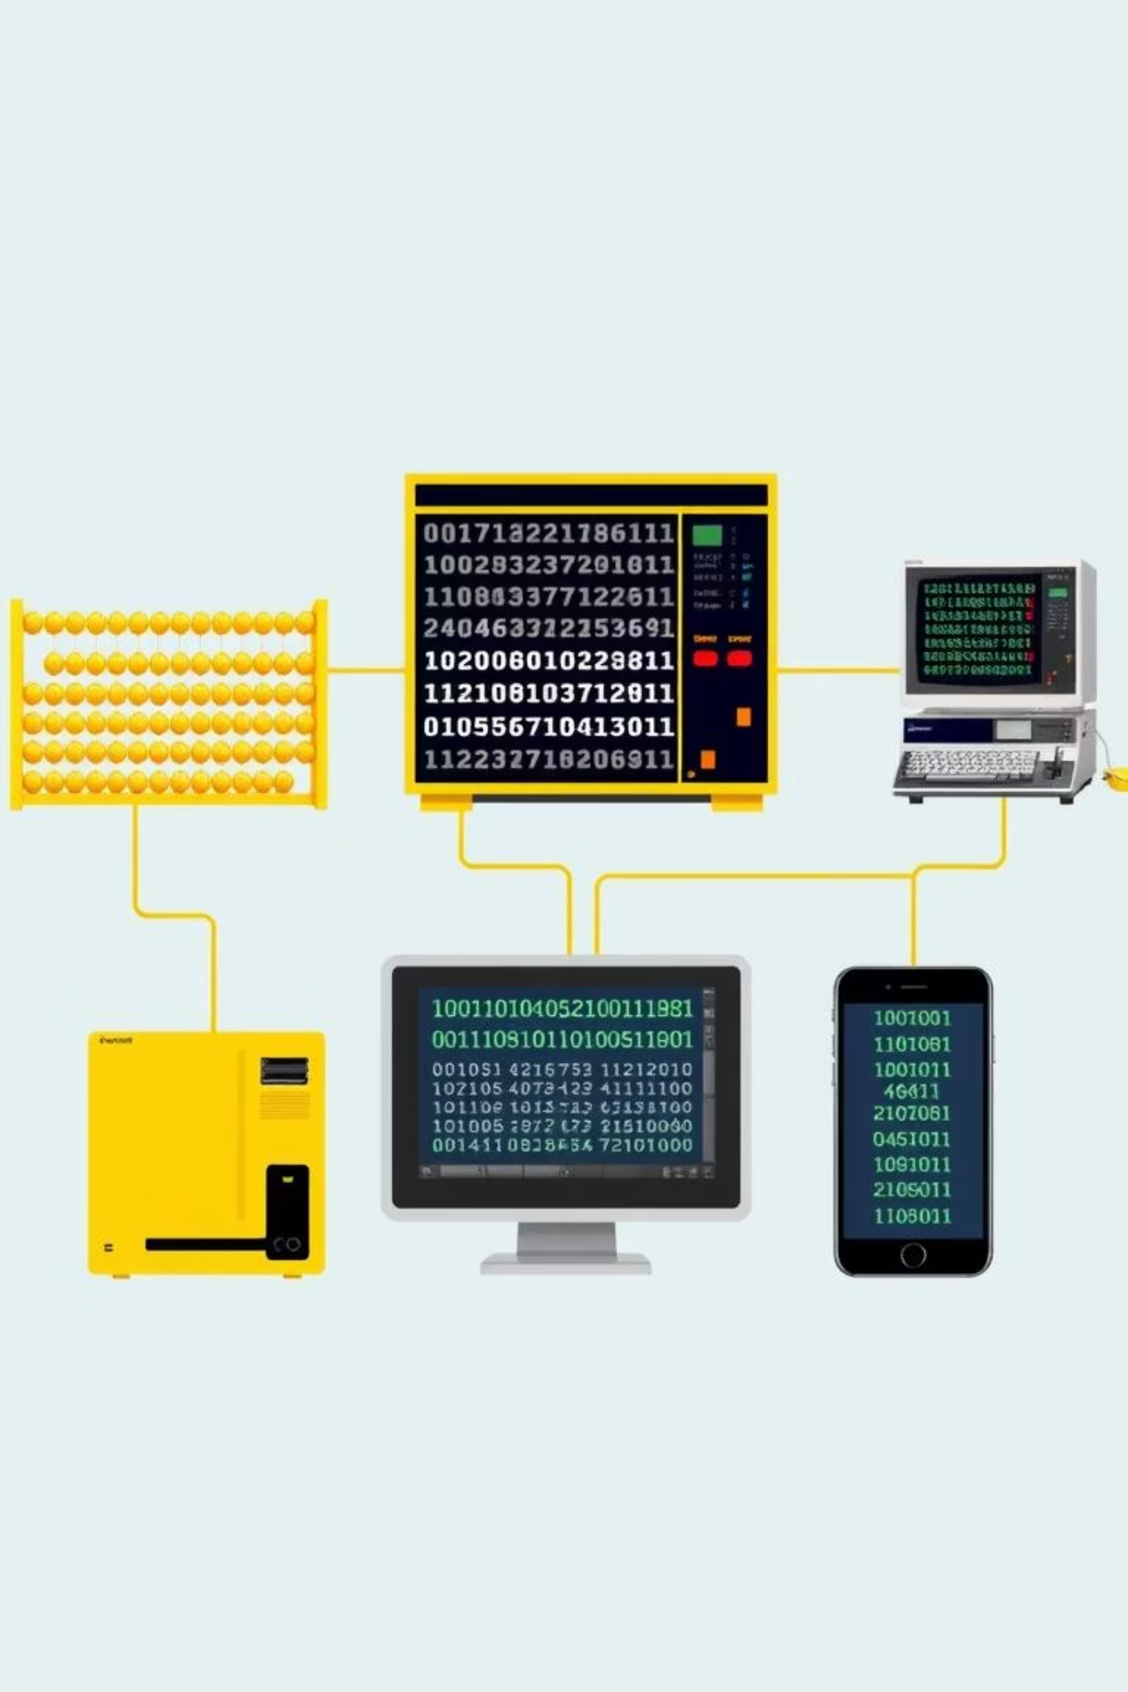
Why We Need More Power: The Evolution of Computing Demands
Basic Computation
Early computers handled single, sequential tasks, adequate for simple calculations and data storage.
Complex Applications
The rise of graphical interfaces, multimedia, and enterprise software demanded more processing prowess for smoother operations.
Data-Intensive Workloads
Modern computing faces unprecedented data volumes from AI, machine learning, big data analytics, and cloud services, requiring immense power.
Concurrent User Experiences
Today's users expect seamless, real-time interactions across multiple applications, necessitating systems that can handle many tasks simultaneously.

Slide 3
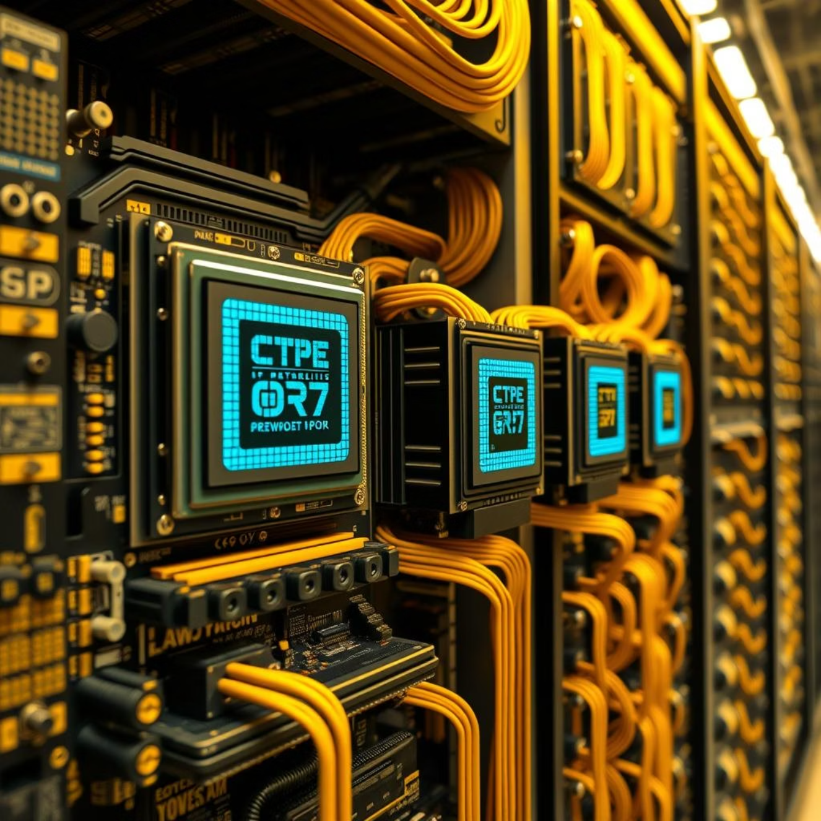
Understanding Multiprocessing: Multiple CPUs, One System
Multiprocessing refers to a system with two or more central processing units (CPUs) that work in parallel to execute multiple programs or processes simultaneously. This architectural design significantly boosts a computer's overall speed and efficiency.
Instead of relying on a single 'brain', a multiprocessing system distributes the workload across several processors, allowing for true parallel execution and faster completion of complex tasks.
This setup is crucial for high-performance computing, servers, and modern workstations where demands for processing power are constant.

Slide 4
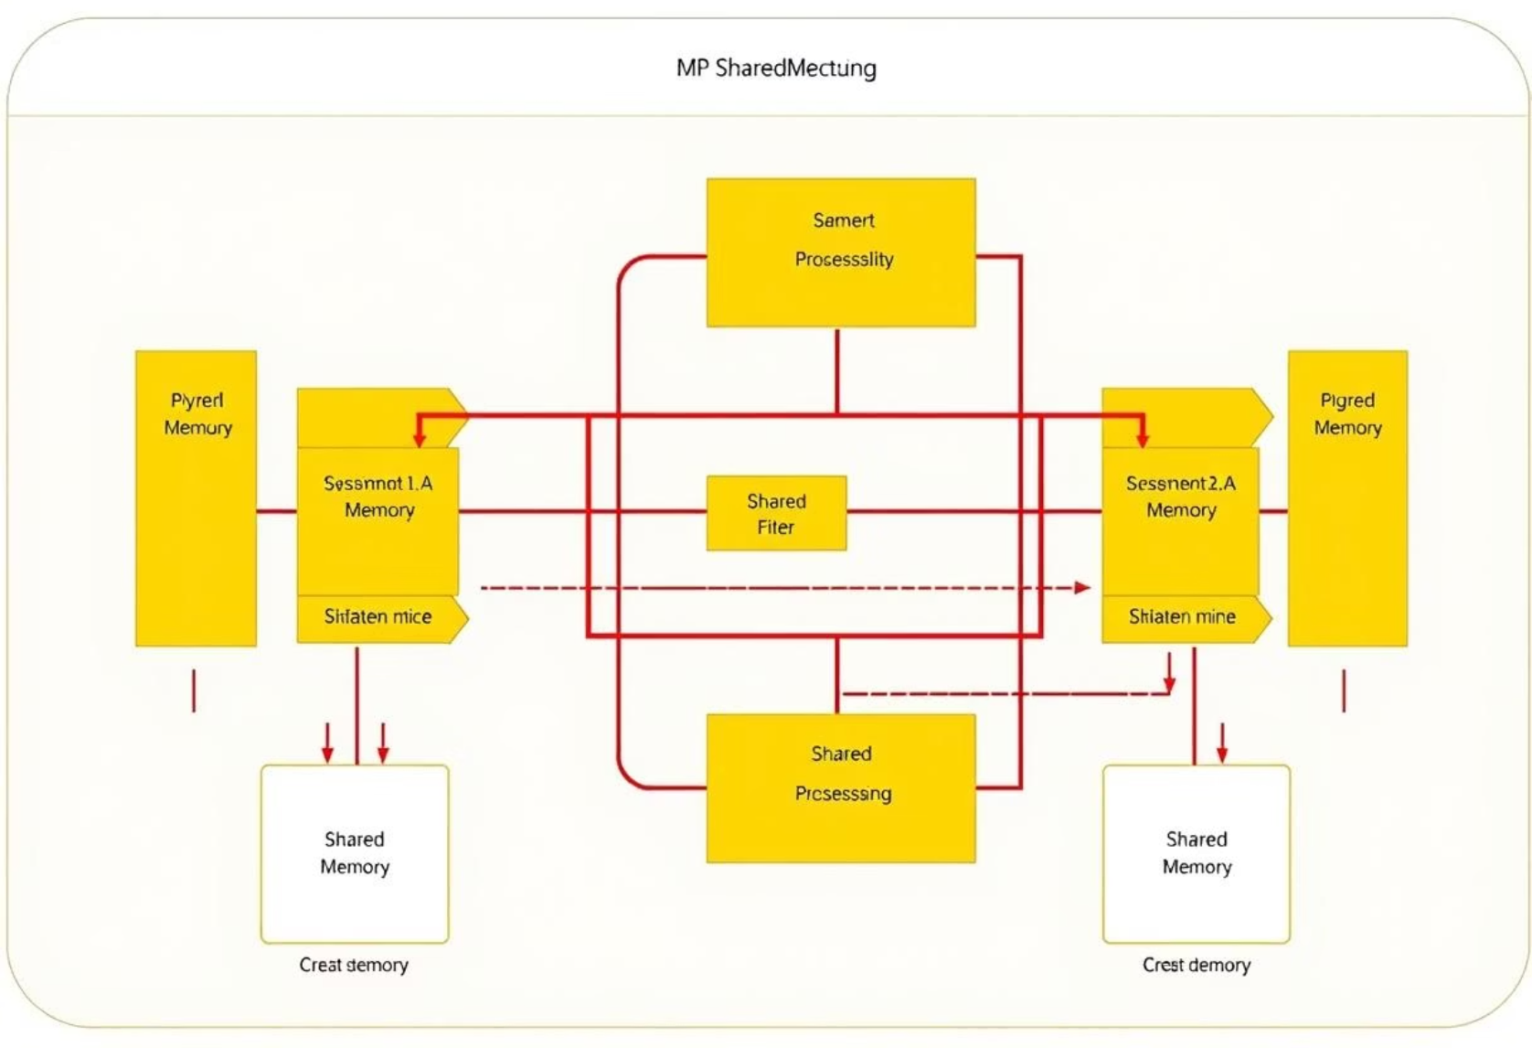
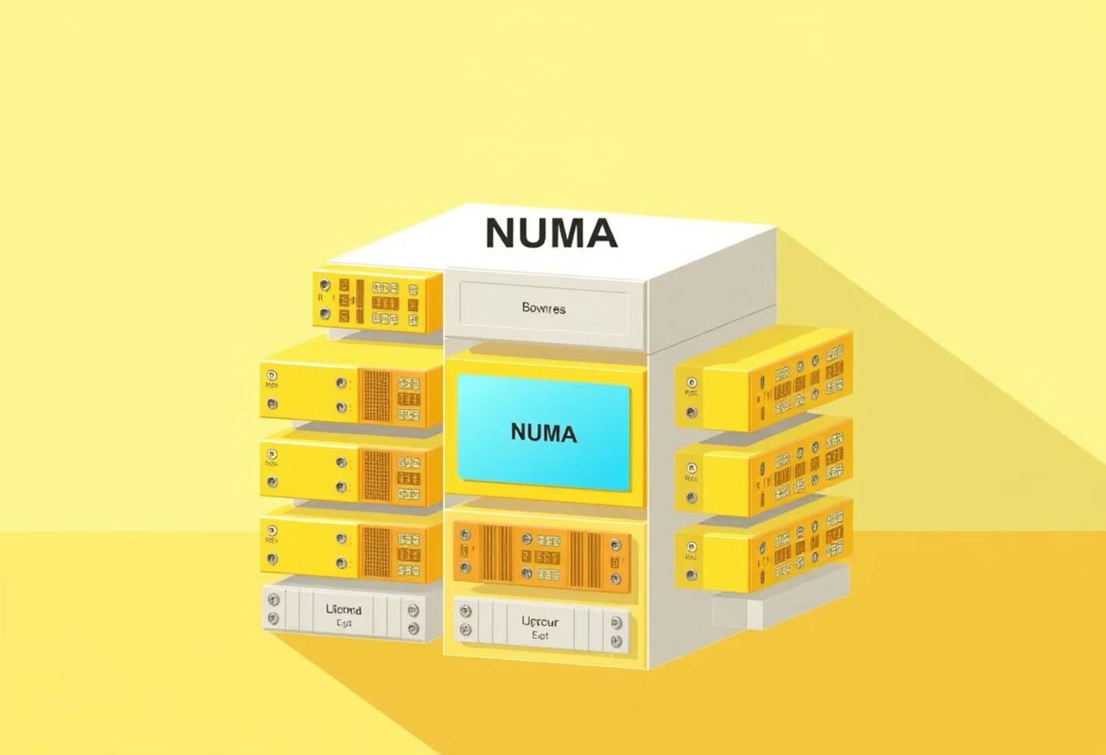
Types of Multiprocessor Architectures: SMP, NUMA Explained
Symmetric Multiprocessing (SMP)
Non-Uniform Memory Access (NUMA)
All CPUs share the same main memory and I/O bus, accessing resources equally. This simplifies management but can lead to memory contention with more processors.
Each CPU has its own local memory, offering faster access to that memory. Accessing memory attached to another CPU is slower. This scales better for very large systems.
Understanding these architectures helps in optimising system performance for specific applications and workloads.

Slide 5





The Power of Parallelism: Benefits of Multiprocessing
Increased Throughput
More tasks can be completed in less time, drastically improving overall system productivity and responsiveness.
Enhanced Performance
Complex, compute-intensive applications execute faster by distributing their workload across multiple processors.
Improved Reliability
If one processor fails, the system can often continue operating with the remaining active processors, ensuring uptime.
Better Scalability
Easily add more processors to scale up computing power as workloads grow, without extensive system redesign.

Slide 6
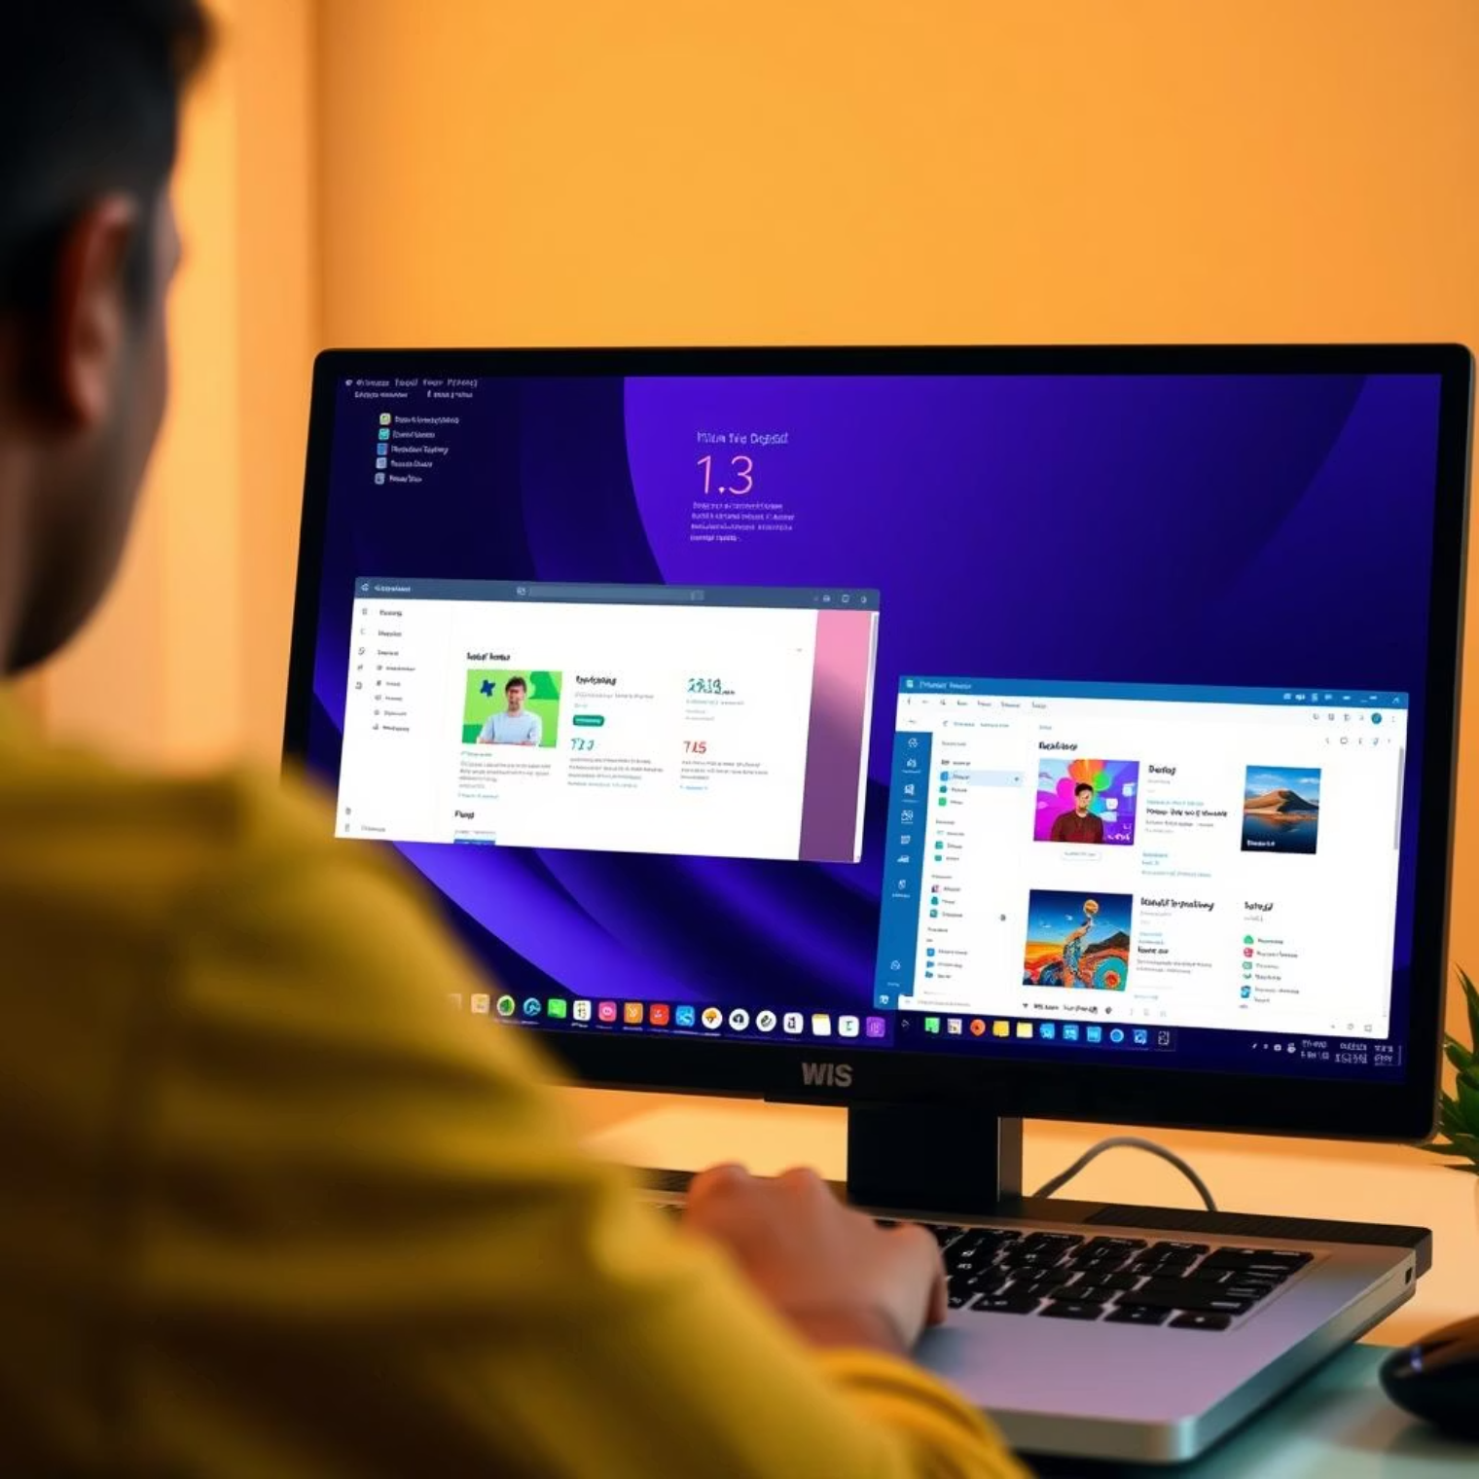
Introduction to Multitasking: Running Multiple Programs Simultaneously
Multitasking is the ability of an operating system to manage multiple processes (or programs) concurrently. While a single-core CPU can only truly execute one instruction at a time, multitasking creates the illusion of simultaneous execution by rapidly switching between tasks.
This capability is fundamental to modern computing, allowing users to browse the web, write documents, listen to music, and download files all at once, creating a fluid and productive user experience.
The quick switching between tasks makes it seem as though they are all running simultaneously, enhancing user productivity.

Slide 7




How Multitasking Works: Schedulers, Context Switching & More
01
02
Time Slicing
The Scheduler
The CPU allocates a tiny fraction of its time, called a 'time slice', to each active process, ensuring fair execution.
The operating system's 'scheduler' decides which process runs next and for how long, based on priority and resource availability.
03
04
Context Switching
Resource Management
When a process's time slice ends, its current state (context) is saved, and the state of the next process is loaded. This rapid saving and loading is 'context switching'.
The OS also manages shared resources like memory and I/O devices, preventing conflicts between concurrent processes.

Slide 8
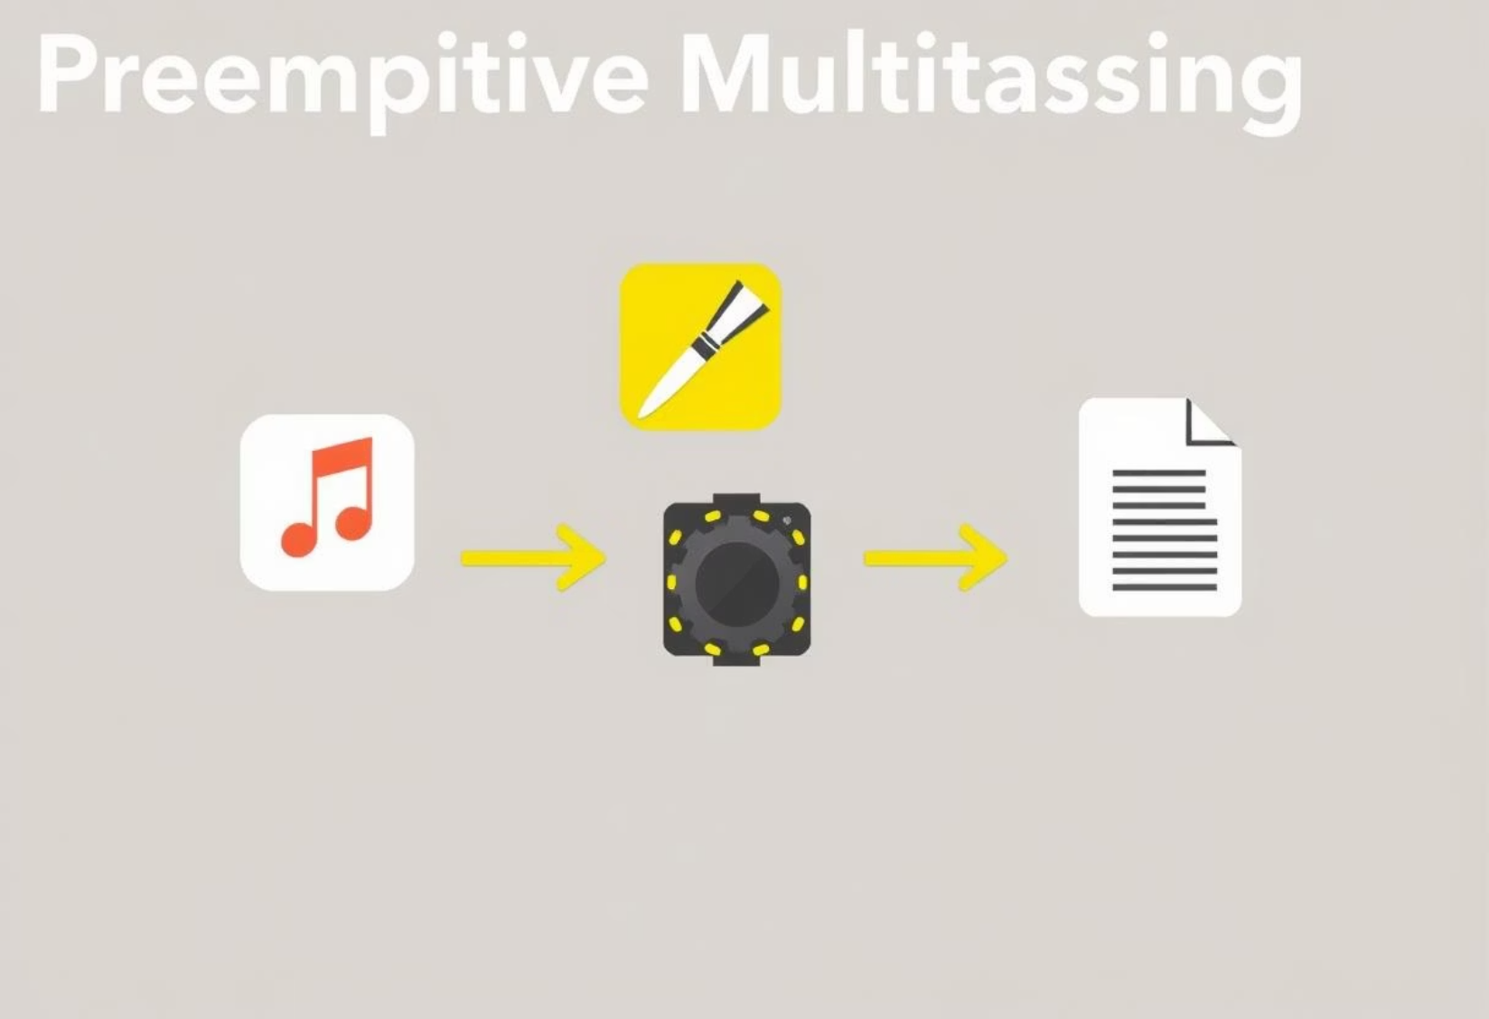

Different Flavours of Multitasking: Pre-emptive vs. Co-operative
Pre-emptive Multitasking
Co-operative Multitasking
The operating system controls when a process is interrupted and another one is run. This ensures that no single application can monopolise the CPU, making the system more stable and responsive.
In this model, processes voluntarily yield control of the CPU when they are ready to do so. If a process does not yield, the entire system can become unresponsive.
While simpler to implement, it is less robust than pre-emptive multitasking and is rarely used in modern general-purpose operating systems, primarily seen in older systems or specific embedded applications.
Most modern operating systems, like Windows and Linux, use pre-emptive multitasking, ensuring a smooth user experience even if one application crashes or hangs.

Slide 9








The Grand Synergy: Multiprocessor & Multitasking in Action
When multiprocessing and multitasking combine, the true power of modern computing is unleashed. Multiprocessing provides the hardware capability (multiple CPUs or cores) for genuine parallel execution.
Parallel Execution
Performance Boost
Multiple tasks from multitasking can be assigned to different CPU cores, executing simultaneously.
This reduces overall execution time for demanding applications and vastly improves system responsiveness.
Server Efficiency
Seamless Experience
Servers handle thousands of concurrent requests efficiently by distributing the load across multiple processors.
Users can run numerous heavy applications without noticeable lag, a testament to this powerful combination.

Slide 10

Future Outlook & Key Takeaways: Next-Gen Computing
Continued Specialisation
Heterogeneous Computing
Future processors will likely feature even more specialised cores (e.g., AI accelerators) for specific tasks.
Integrating various types of processors (CPUs, GPUs, FPGAs) will become more common for optimal performance.
Ubiquitous Parallelism
From edge devices to supercomputers, the principles of multiprocessing and multitasking will remain central.
The journey of computing power continues, with these foundational concepts paving the way for innovations like quantum computing and advanced AI.

